Slide 1
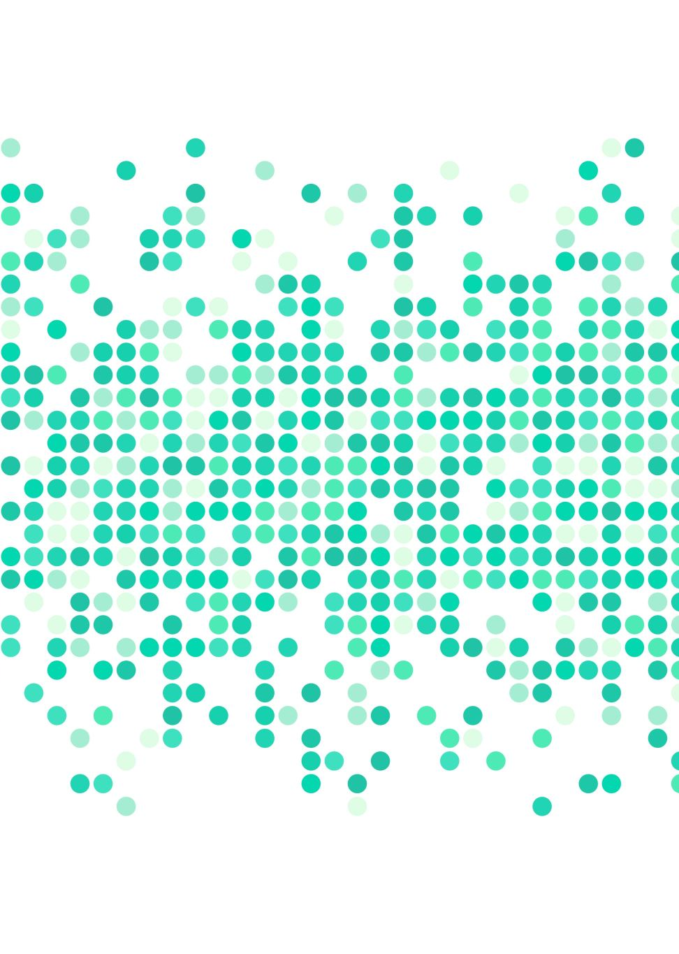
Predictive Analysis for Injury Diagnosis and Localization
Michael Whittington
11/14/2023
Notes:
Hello, my name is Michael Whittington and my project is titled “Predictive Analysis for Injury Diagnosis and Localization”

Slide 2
Outline
Project Overview and Background
Dataset Overview
Exploratory Data Analysis
(Demo)
Models Overview and Results
Conclusion
References
Model Application
(Demo)

Slide 3

Project Overview + Background
Importance of Predictive Analysis in Public Health
Societal Implications
Predict and prevent injuries
Understand safety of consumer products
Expedite medical treatment
Enhance safety measures of consumer products
Optimize medical care with data-driven methodologies
Primary Project Goals
Methods
Predict accurate diagnosis of patient injuries
Determine specific body part affected
Use of machine learning models
Employ data analysis techniques
Discern patterns and correlations
Notes:
For those that may have missed my prior presentations, I want to quickly recap my project overview and background.
The goal of my project is to use this dataset to find patterns in the data and accurately predict both the diagnosis of a patient's injury and the body part where it occurred. Ultimately, by understanding these injuries, companies can make safer products, and doctors can treat patients faster and better. This helps in making products safer and improving medical care for everyone. In order to accomplish this, I plan to use machine learning models and refine those models using other data science techniques.

Slide 4




Dataset overview
 | Location | → | cpsc.gov (https://www.cpsc.gov/cgibin/NEISSQuery/home.aspx)
 | File Format | → | CSV
 | Schema Information | → | 25 columns 323,343 rows
 | Context | → | Dataset features 2022 patient data from emergency rooms across the U.S., documenting product-related injuries and demographics for research.
Notes:
Here is a brief overview of the dataset that I will be using, which comes from the Consumer Product Safety Commission. The dataset is fairly robust, featuring over 300,000 rows and 25 columns, where each row is a patient that went to a participating hospitals emergency room in the year 2022.

Slide 5
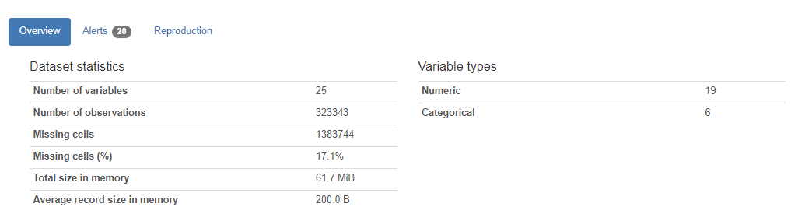
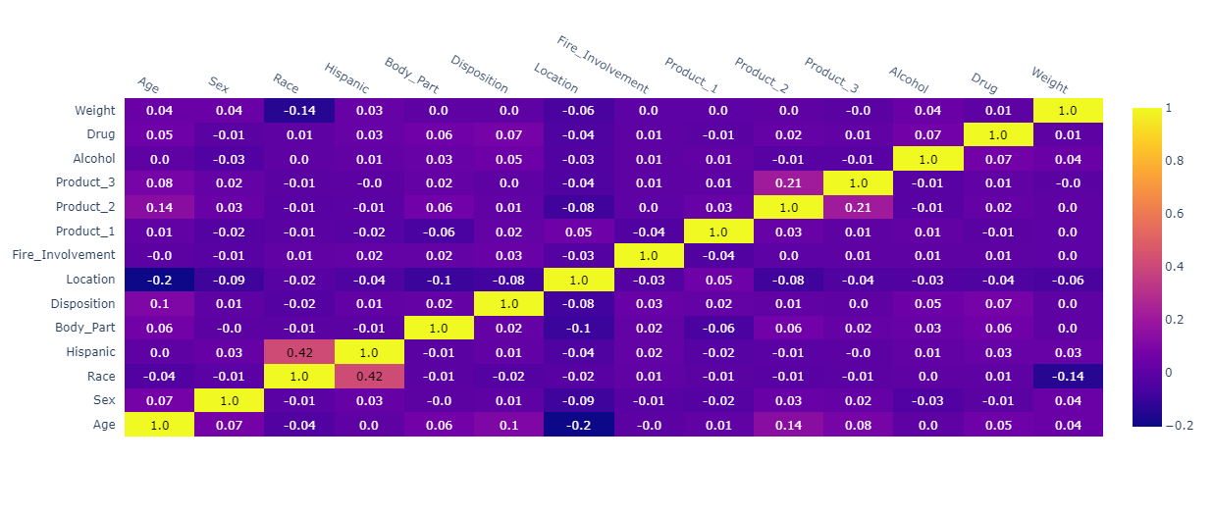
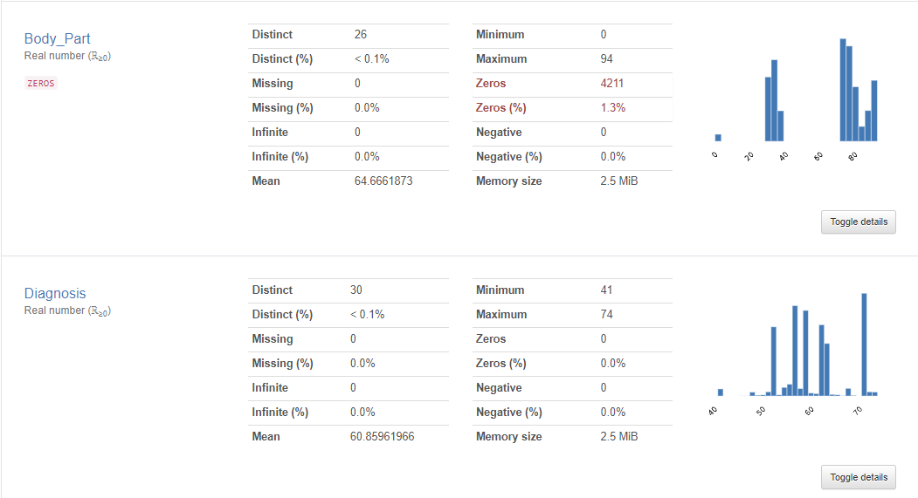
Exploratory Data analysis
Using Pandas Profiling and Plotly the following reports were generated
The overall report includes variable deep dives, interactions between variables, missing values analysis, etc.
Pandas Profiling - Overview Report
Plotly - Correlation Matrix
Target Variables - Overview

Slide 6
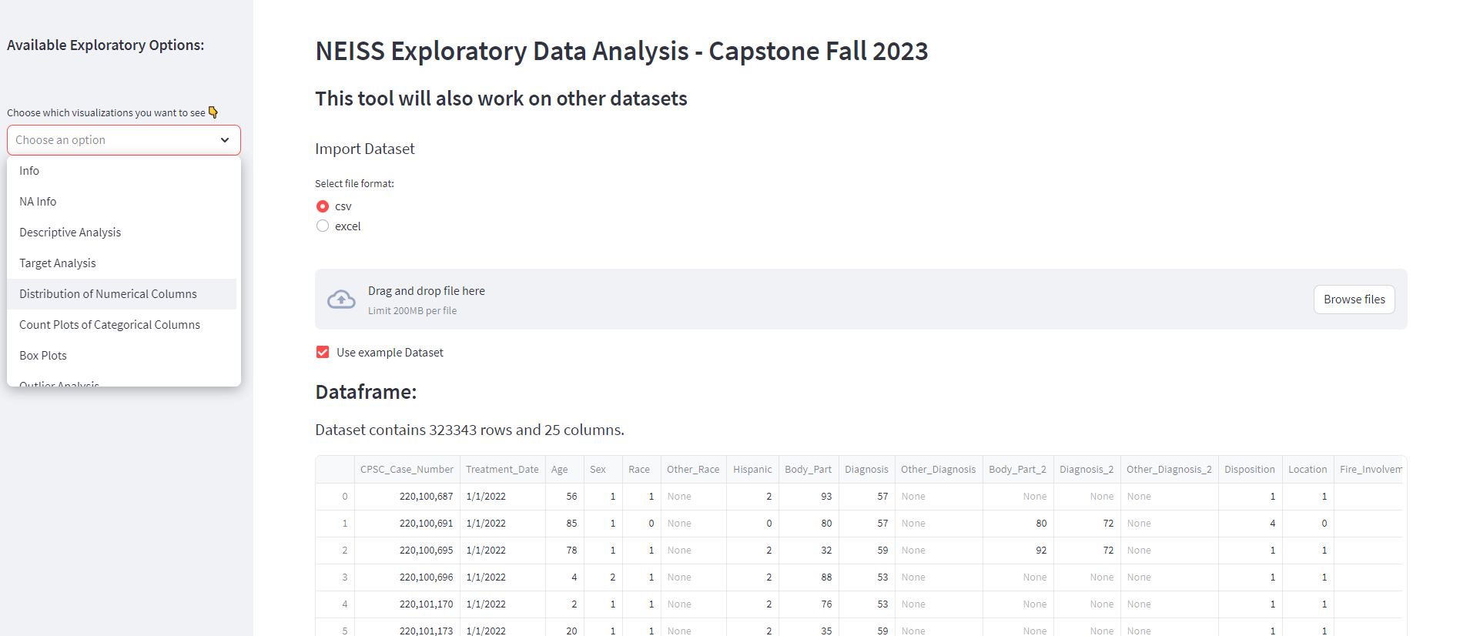



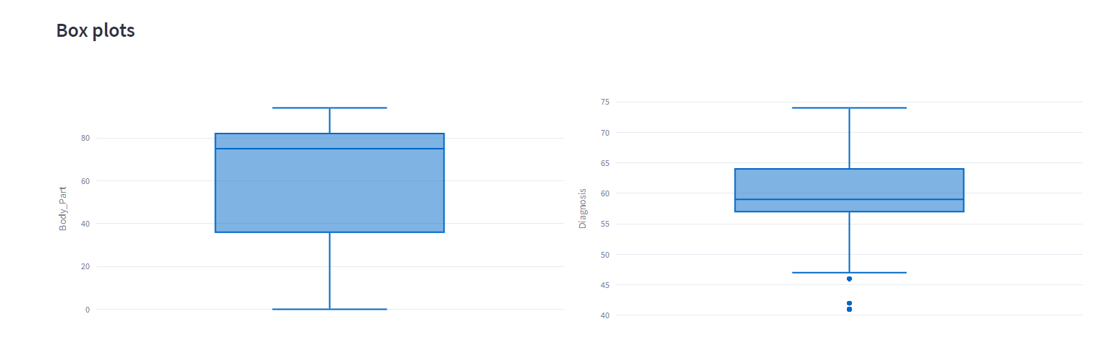


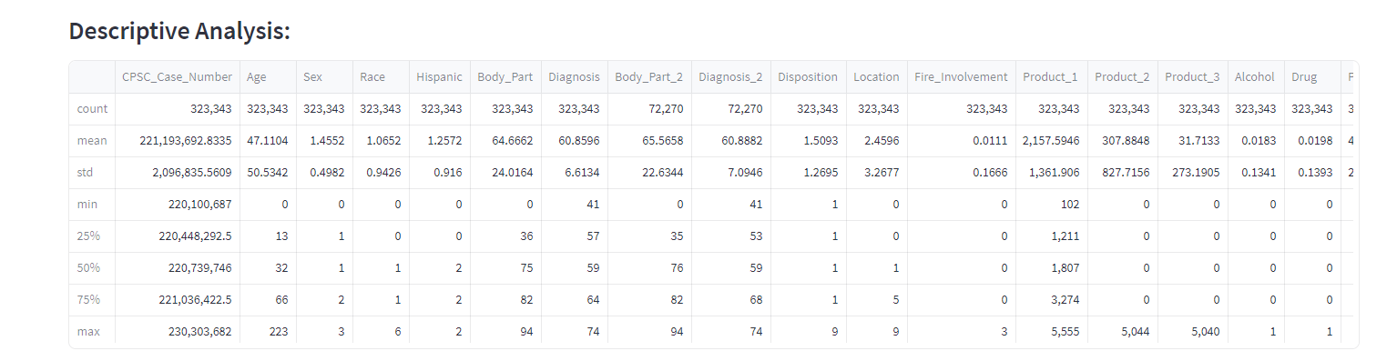
EDA Application Demo
Technologies Used

Slide 7
Model overview + Enhancements
Train/Test Information:
Dataset was split 80 (train data)/20 (test data)
Models Tested:
Random Forest
XGBoost
LightGBM
CatBoost
K-Nearest Neighbors
Improvement Methods:
Hyperparameter Tuning
Cross-Validation
Feature Importance
Stacking and Blending
Other Models Tested: Support Vector Machine (SVM), Decision Trees, Logistic Regression, etc.
Notes:
Hyperparameter Tuning:
Grid Search/Random Search: These are exhaustive methods to search through a predefined set of hyperparameters.
Bayesian Optimization: A more efficient method than the exhaustive search, especially for models with many hyperparameters like XGBoost.
Cross-Validation: Always use cross-validation to get an unbiased estimate of the model's performance.
Feature Selection:
Recursive Feature Elimination (RFE): This can be especially effective with SVM and Logistic Regression.
Feature Importance: Algorithms like RF and XGBoost provide feature importance scores. You can use these scores to select a subset of the most influential features.
Regularization: L1 regularization (Lasso) can help in feature selection by pushing some feature coefficients to zero, especially in Logistic Regression.
Ensemble Methods:
Bagging: Like using multiple random forests.
Boosting: Algorithms like AdaBoost, Gradient Boosting Machine (GBM), and XGBoost.
Stacking: Train multiple classifiers and use another classifier or regression model to make the final prediction based on the outputs of the first-layer classifiers.

Slide 8
Results - Accuracy
Model Type | Body Part |  | Diagnosis
 | Initial Model | Model + Enhancements | Initial Model | Model + Enhancements
Random Forest | 42% | 46% | 54% | 58%
XGBoost | 48% | 48% | 60% | 60%
LightGBM | 47% | 45% | 58% | 52%
CatBoost | 44% | 45% | 55% | 59%
K-Nearest Neighbor | 33% | 37% | 43% | 44%

Slide 9
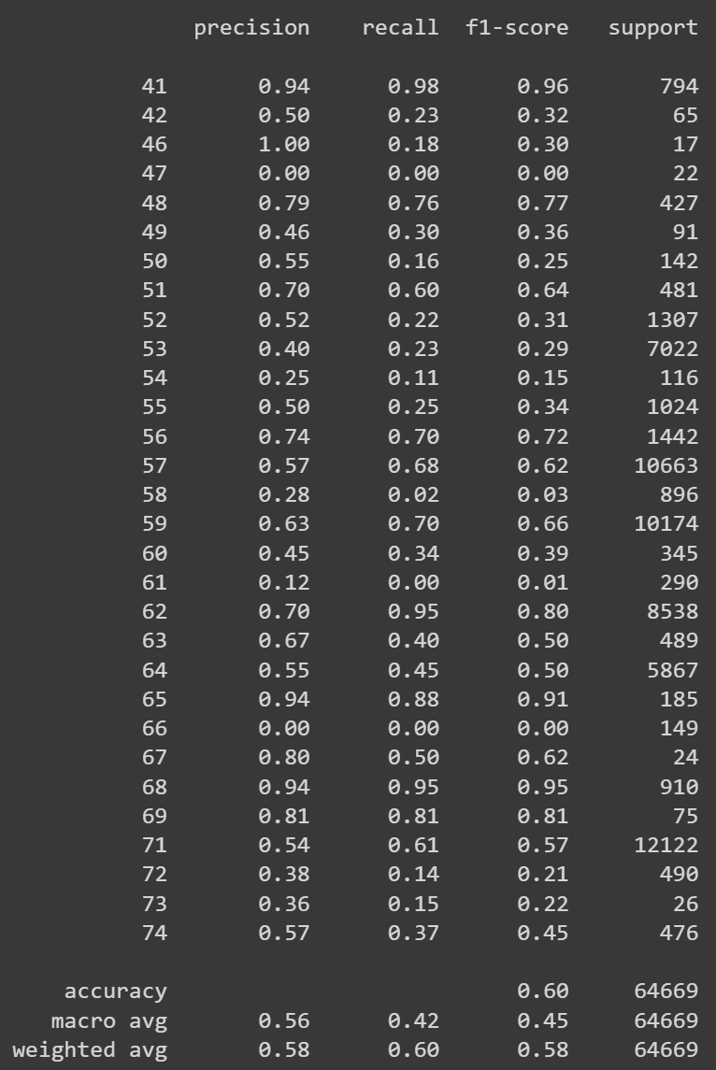
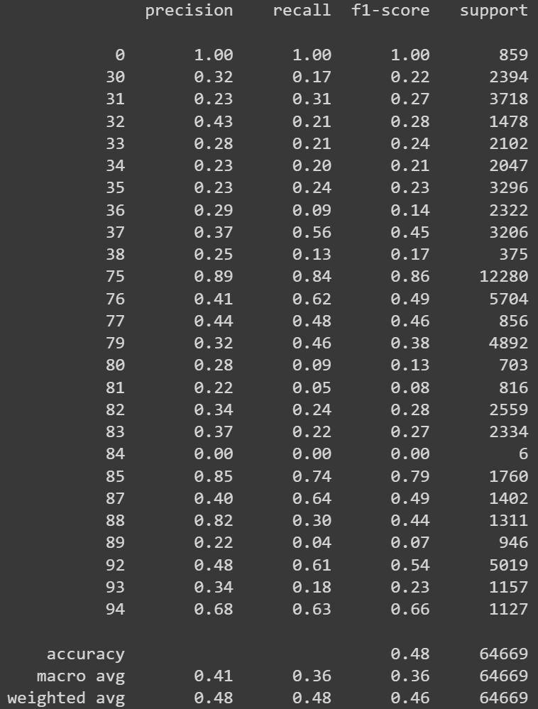
Deeper dive – xgboost model
Diagnosis – Classification Report
Body Part – Classification Report
Notes:
If you look across the board, Diagnosis performs better in precision, recall, f1, and accuracy. Notably about 10 of the 30 classes performed well, with an additional 10 performing moderately.
While only 2 classes, 0 and 75 stand out as body_parts that performed well. 75 actually indicates the “Head” body part and has the most occurrences in the dataset.
Precision measures the accuracy of positive predictions. In other words, it tells you what proportion of predicted positives are truly positive.
Recall measures the ability of a model to find all the relevant cases within a dataset. It tells you what proportion of actual positives was identified correctly.
The F1 score is a balance between precision and recall. It is particularly useful when you need to balance these two metrics, especially when the costs of false positives and false negatives are very different.

Slide 10
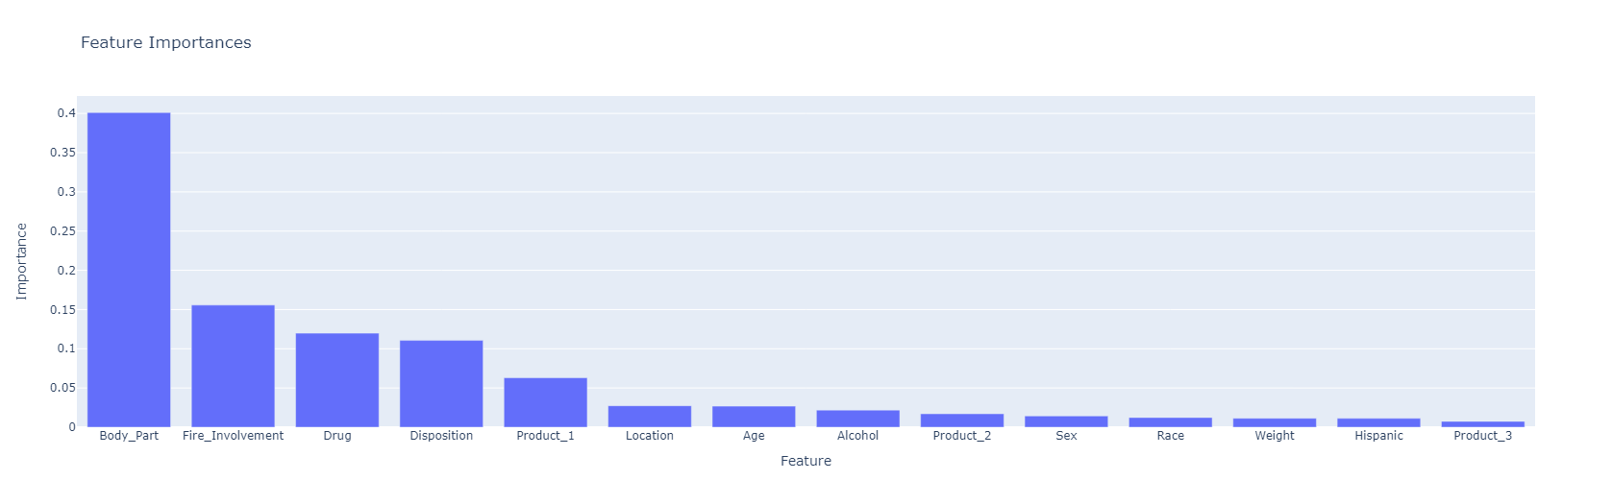
Deeper dive – xgboost model (diagnosis)
Notes:
I did test out the feature importances of the XGBoost Model and while this does share some surprising insight (ie that Age and Sex don’t play a more important role in predicting the Diagnosis), when it was tested these ultimately did not alter the prediction accuracy very much at all.

Slide 11
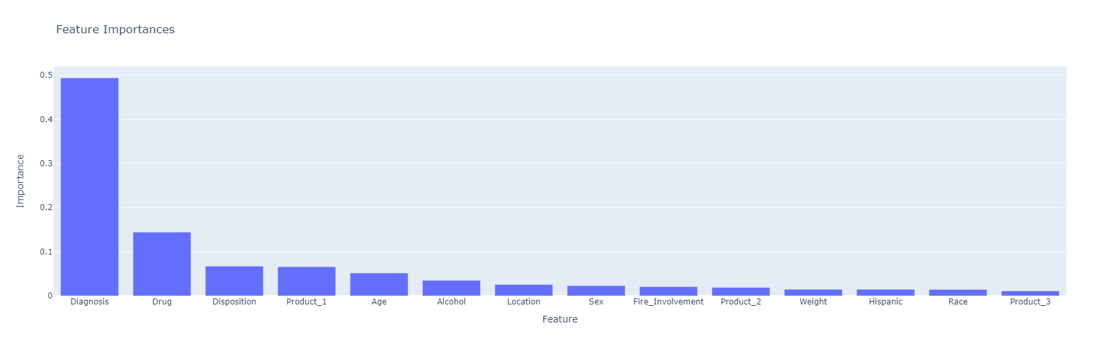
Deeper dive – xgboost model (body part)
Notes:
This is very similar to the Diagnosis feature importances. The main difference (outside of Diagnosis vs Body Part) is that Fire Involvement and Disposition play much less of a role as features for the body part prediction.

Slide 12
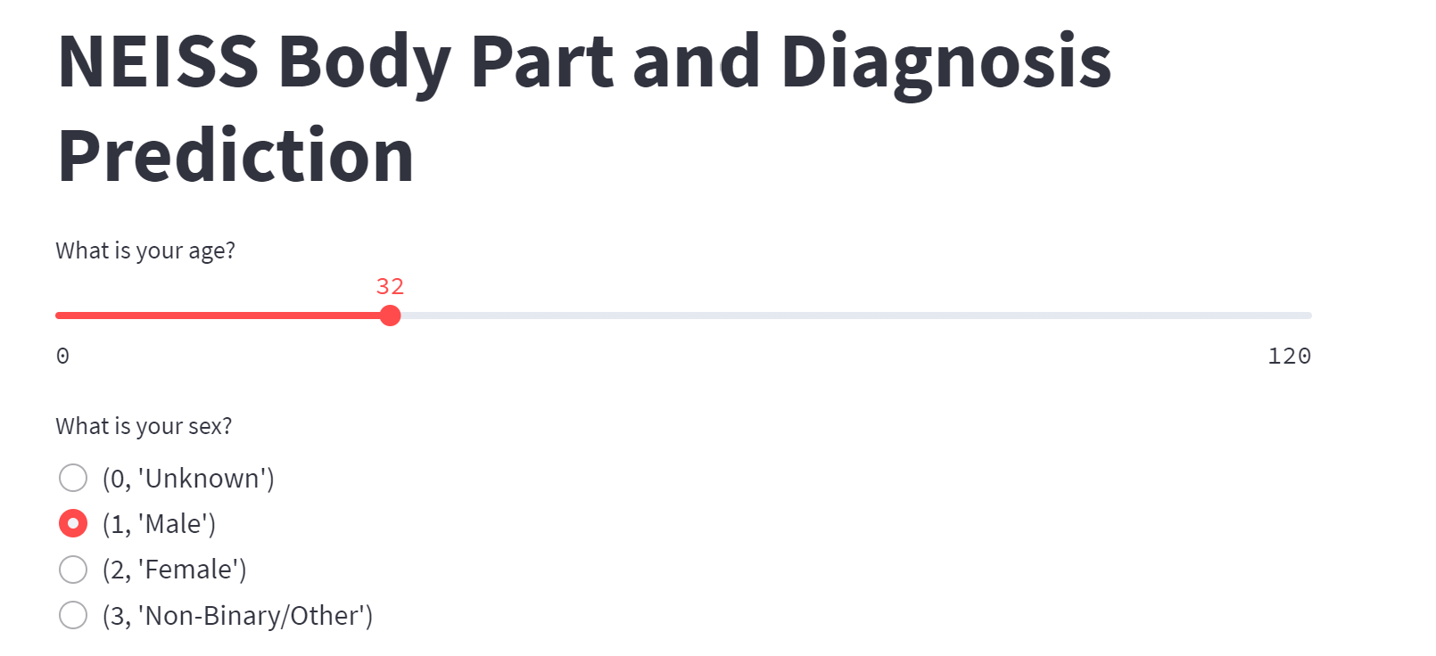
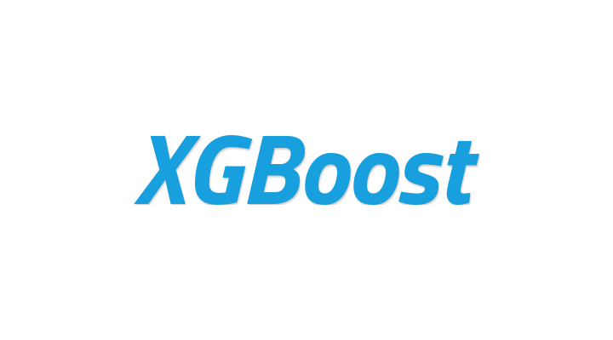
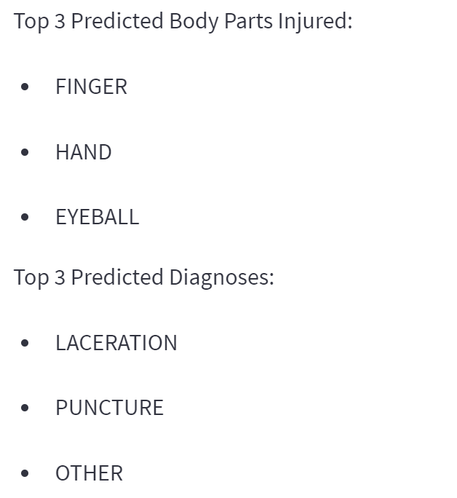
Model Application Demo
Application – Insert Information
Technologies Used
Provides Predicted Answer
Notes:
Next, I will demo my application, which allows the user to enter information and the application will provide the top 3 likely body parts injured and the top 3 predicted diagnoses.
The creation of this application was done using Streamlit and the other technology show on the slide.

Slide 13
Conclusion
Future steps
Diagnosis prediction results outperformed body part predictions
Limited model improvement from hyperparameter tuning and feature importance
Dataset may lack a clear pattern or distinction between classes
You don’t always get the results you expect!
Add in more data to determine whether the data is the issue
Additional evaluation metrics
More compute power
Notes:
More compute power – ran into problems with the size of this dataset. This could allow for a more thorough analysis of the hyperparameters, plus it would be necessary if more data was added to this project.

